Slide 1

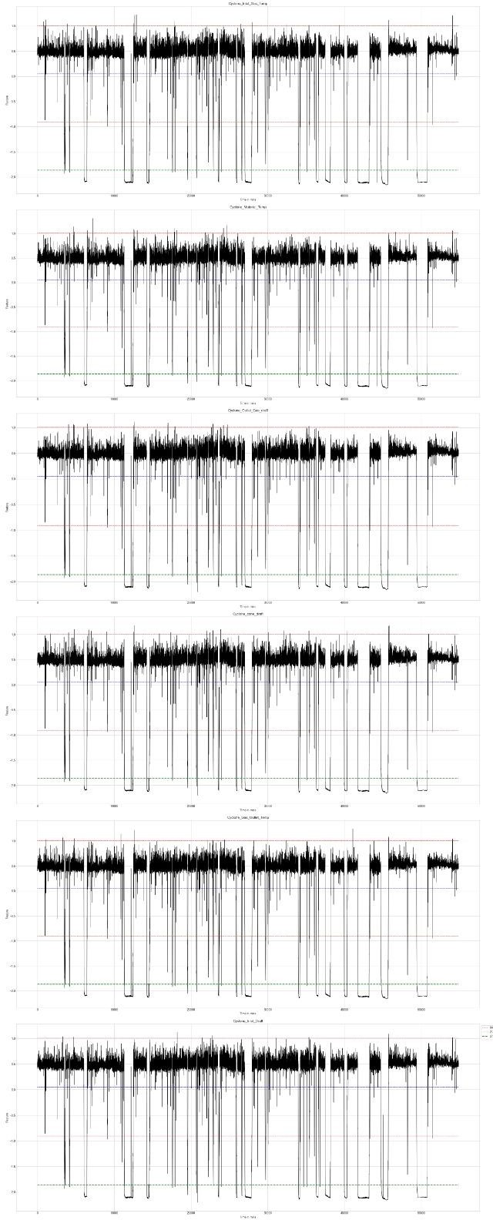
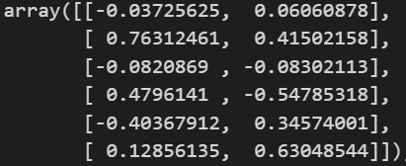
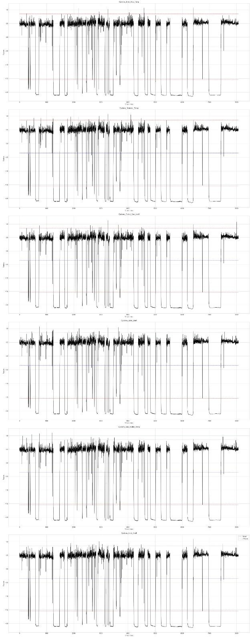
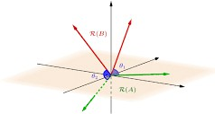
Fatigue Detection in Badminton Players
Atishay S G, Ancitha Mary, Mythreyi R, Shashank S
Under the guidance of Prof. Sudarshan N Acharya
AIM
To detect fatigue among badminton players .
EXPLORATORY DATA ANALYSIS (EDA)
2. PCA between matrices:
We consider the 30 min observation for anomaly detection , which gives us a 6*6 matrix for each 30 min time stamp. The PCA is measured between two 6*6 matrices, and the components defining maximum variance are considered.
Timestamps under which the powerplant works perfectly five plotted across six features.
OBJECTIVES
Analyze changes in badminton players' gait patterns.
Identify peak moments in physical activity using peak detection.
Correlate gait changes with performance levels and fatigue states.
Develop a reliable fatigue detection system.
Outlier Detection
Trimming Data
Data
Preprocessing
RESULTS
Anomalies across features
DATA
Slicing
The data consists of 5 features and a large number of sensor data , where each time stamp corresponds to 2 milli-seconds.
The data considered has only continuous columns.
Peak Detection
METHODOLOGY
continuous_cols
1. Angle between subspaces :
Time (s)
Acceleration x (m/s^2)
where,
Acceleration y (m/s^2)
- Angle between subspaces
Acceleration z (m/s^2)
- Minimum most eigen value
Absolute acceleration (m/s^2)
CONCLUSION
The ratio of anomalies to non-anomalies may or may not vary with the change in duration consideration.
RESEARCH POSTER PRESENTATION DESIGN © 2019
www.PosterPresentations.com

